Slide 1



Intro to Flutter

Slide 2
What is a Widget?
Each element on the screen of the flutter app is a widget. The structure of code of apps is a tree of widgets.
Flutter is a Widget inside a Widget inside a widget,..
Types of Widgets:
Stateless Widget
Statful Widget

Slide 3
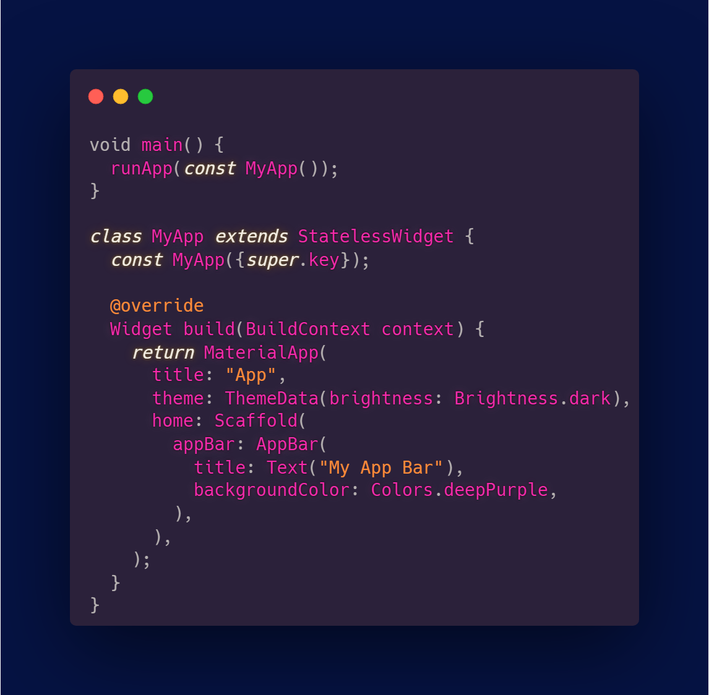
Stateless Widget
Stateless widget is a widget which once built, it’s properties and state can’t be changed.

Slide 4
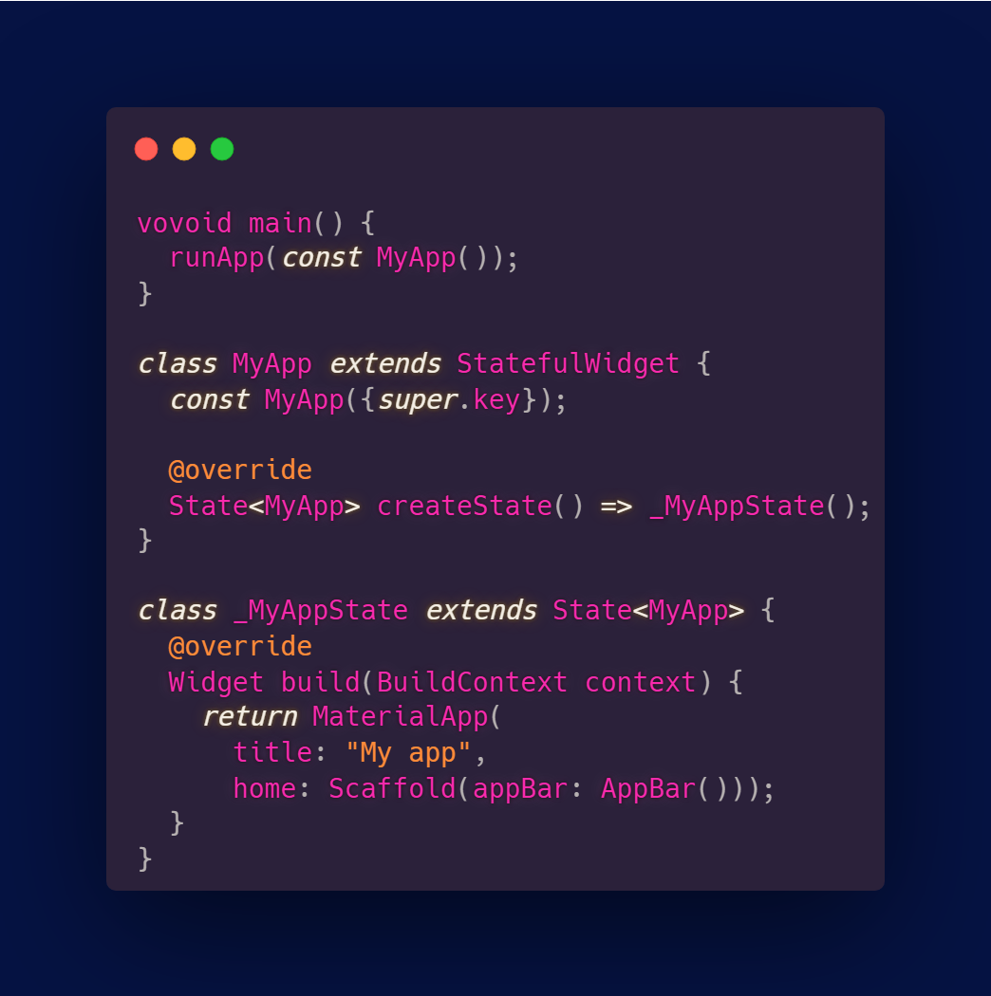
Stateful Widget
Stateful widget is a widget that can change state, it can updateand rebuild the appearance.

Slide 5
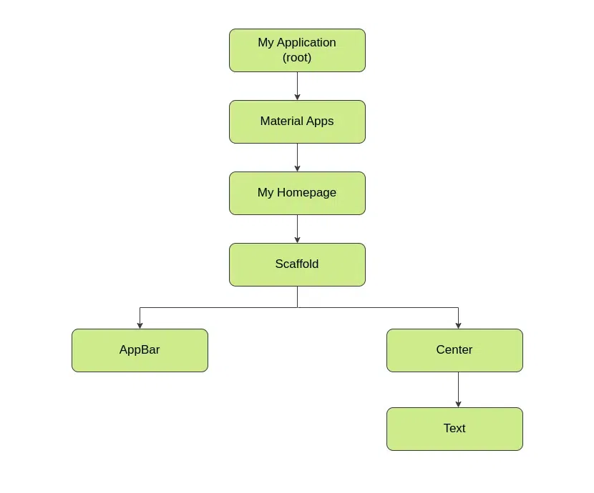
Widget Tree

Slide 6
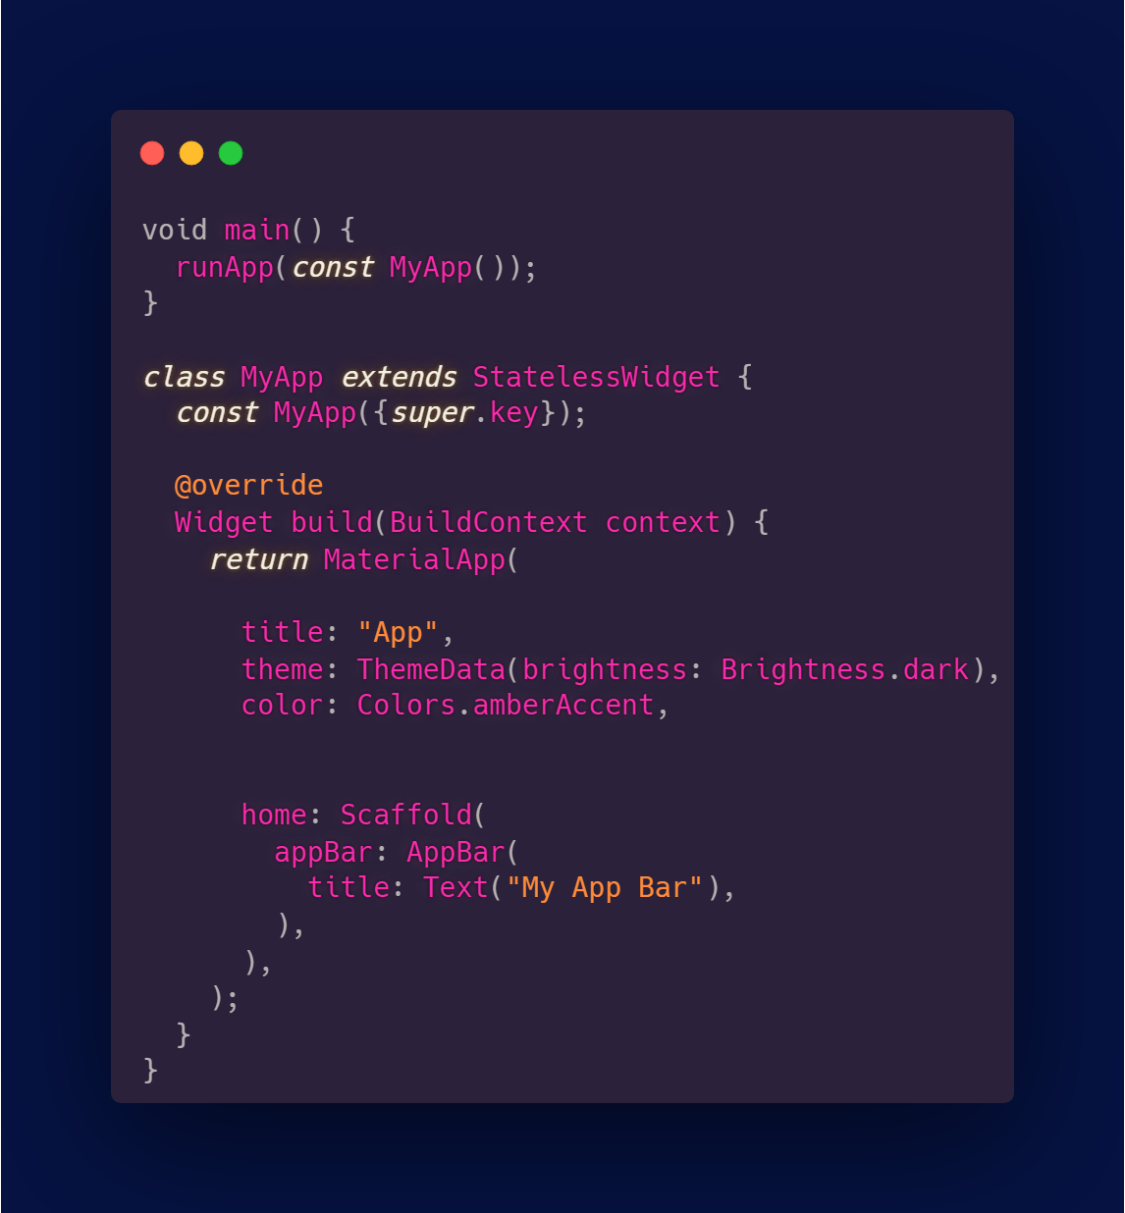
Material App
The MaterailApp is a predefined class or widget in flutter.
It provides a wrapper around other widgets.

Slide 7
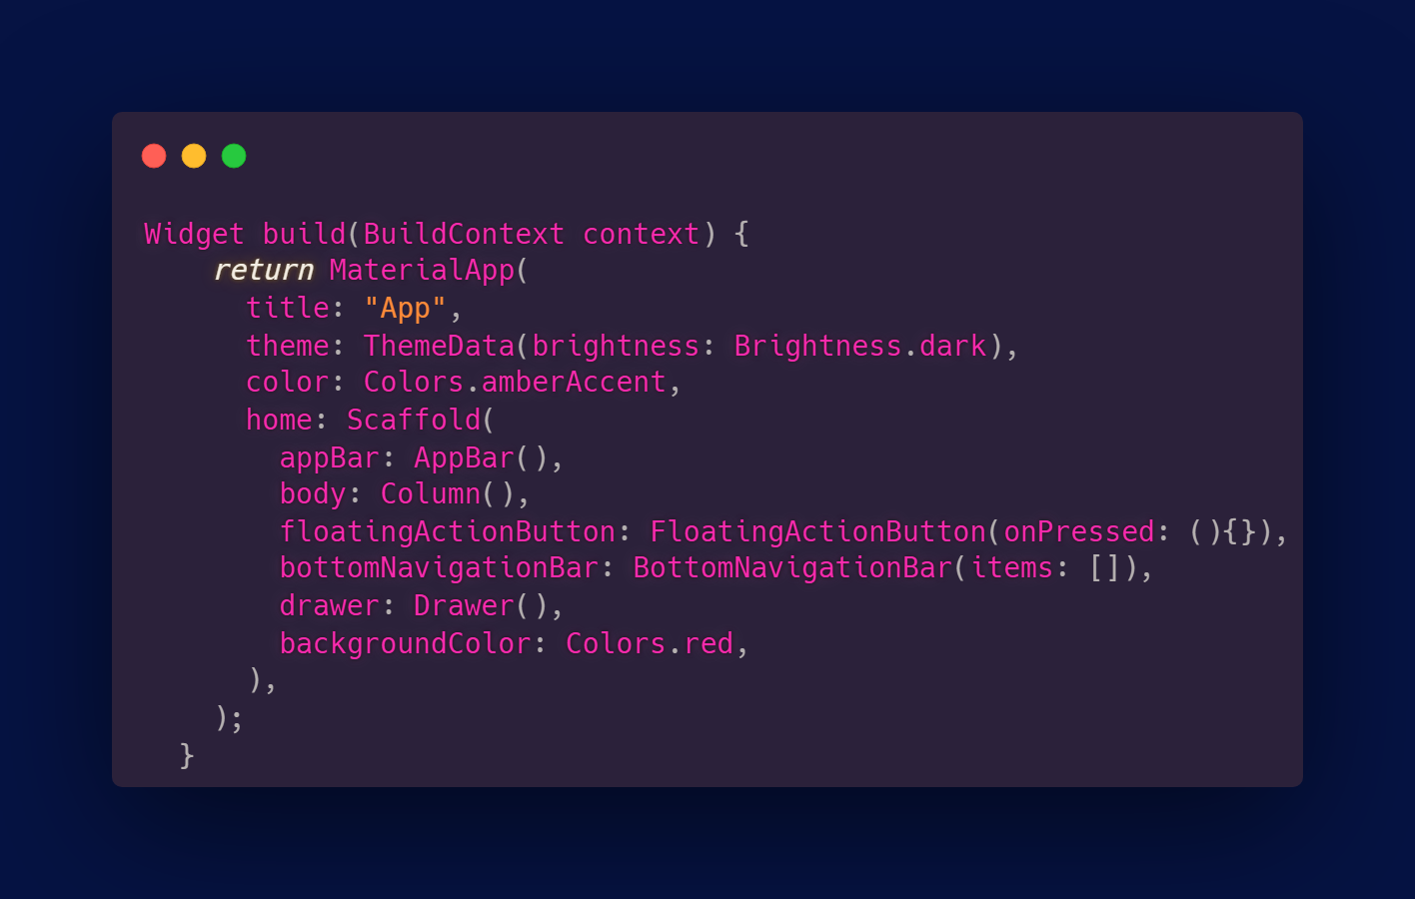
Scaffold
The Scaffold is a class that provides amny widgets.
The Scaffold will occupy the whole available screen.

Slide 8
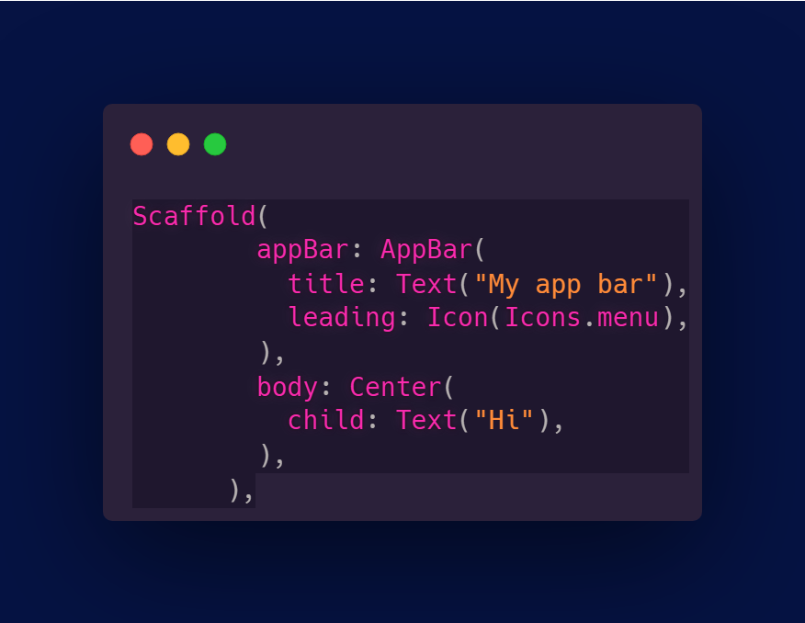
AppBar
It’s the topmost component in the app.
A title puts the given widget in the center of the empty app bar.
And the leading puts the widget in the left most spot in the app bar.

Slide 9
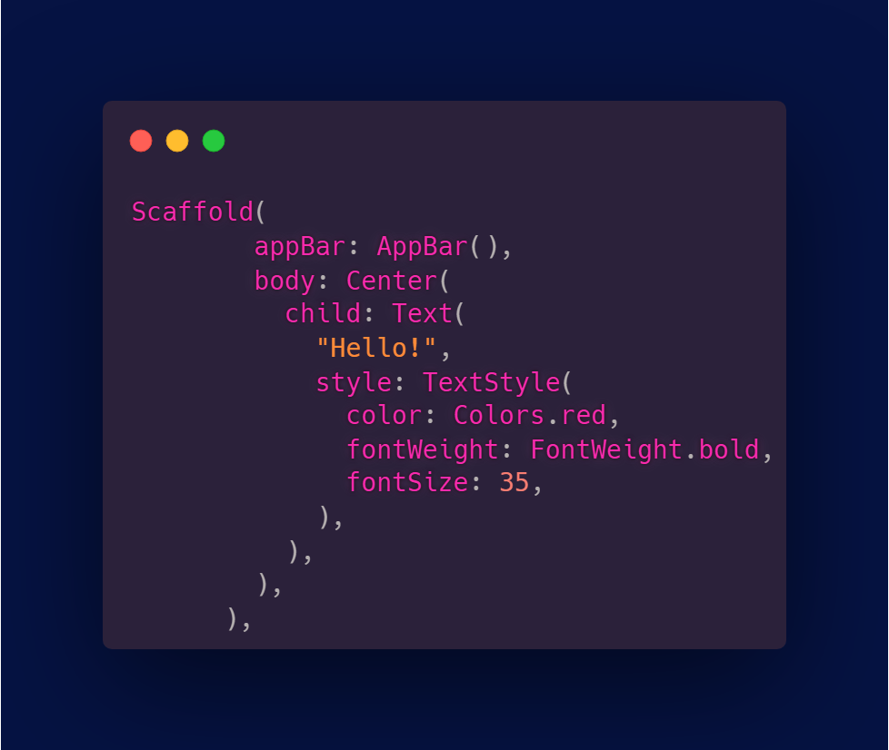
Text
To display a text in the app.
You can change the text’s color, size, weight using TextStyle().

Slide 10
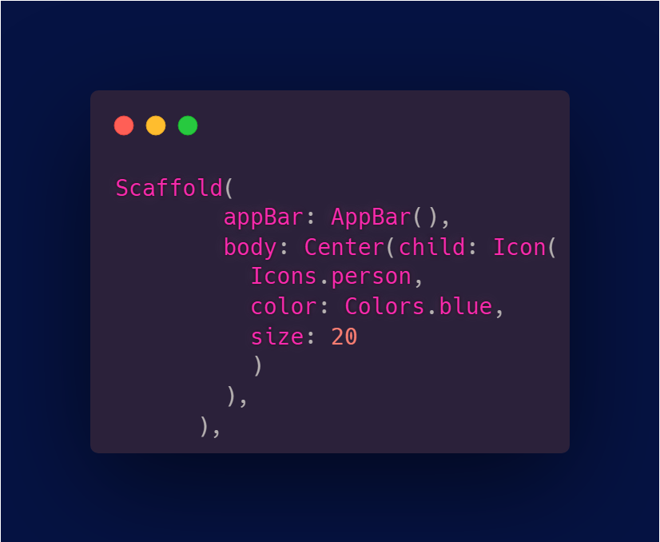
Icon
It displays an icon, you can change its color, size and weight.

Slide 11
Center
The Center widgets aligns its child widget in the center of the empty screen.

Slide 12
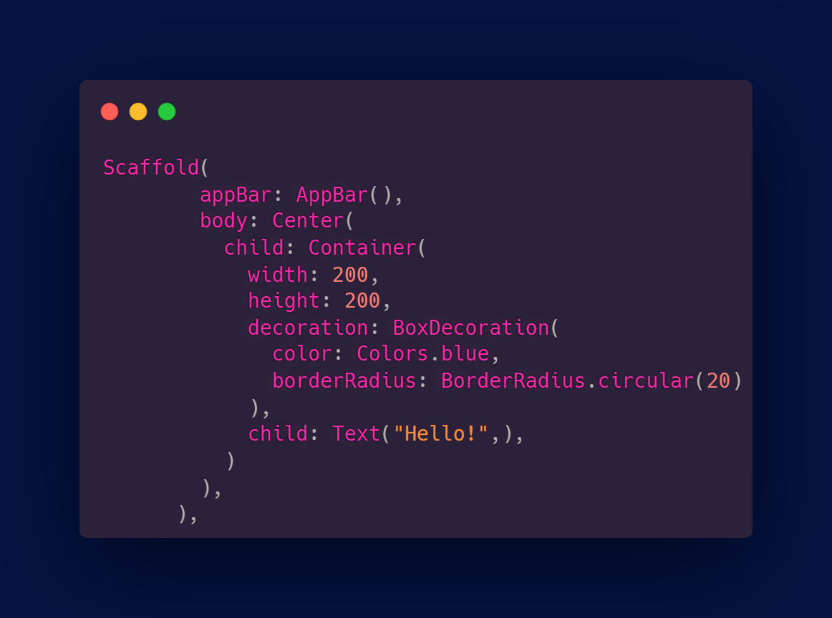
Container
A convenience widget that combines common painting, posioning, and sizing widgets.

Slide 13
Container
A convenience widget that combines common painting, posioning, and sizing widgets.

Slide 14
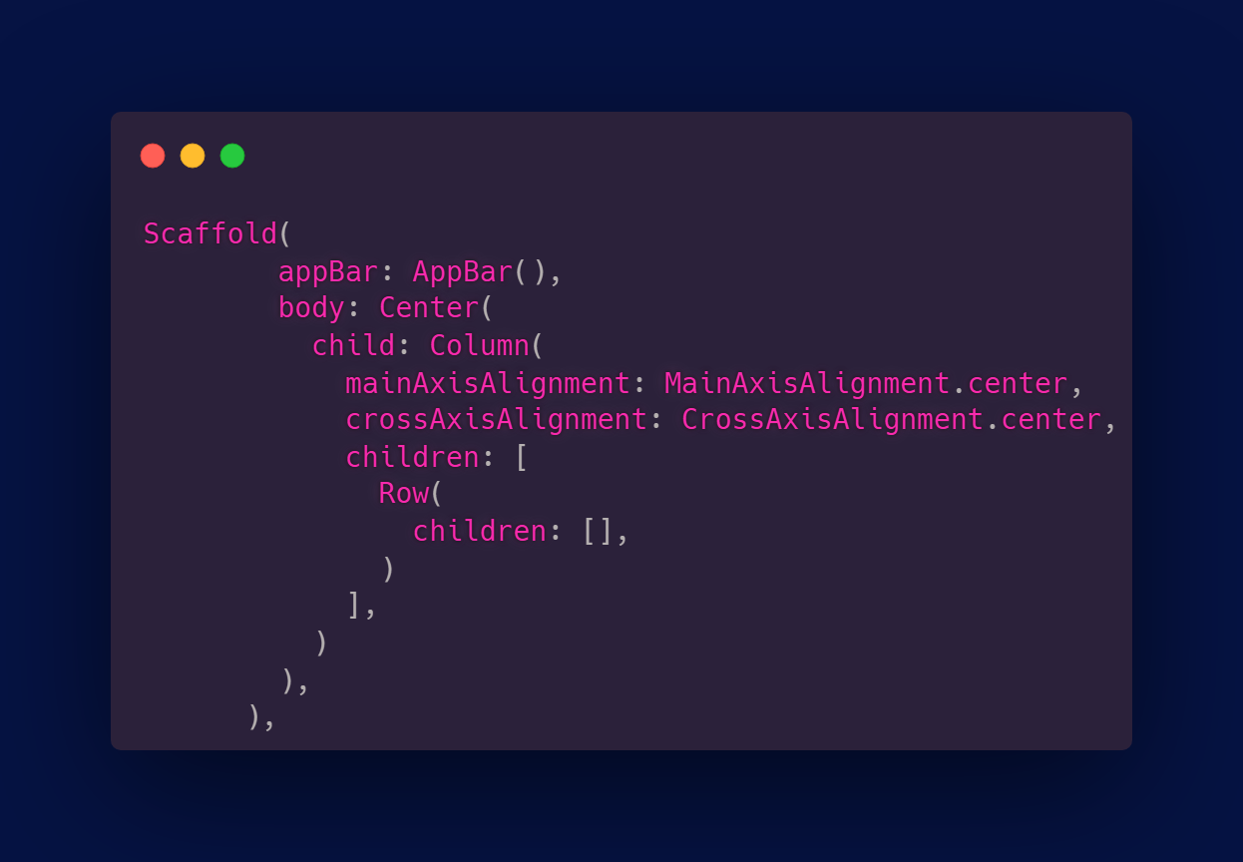
Columns & Rows
The column takes childern widgets and alings them virtically, while the row alings them horizontally.

Slide 15
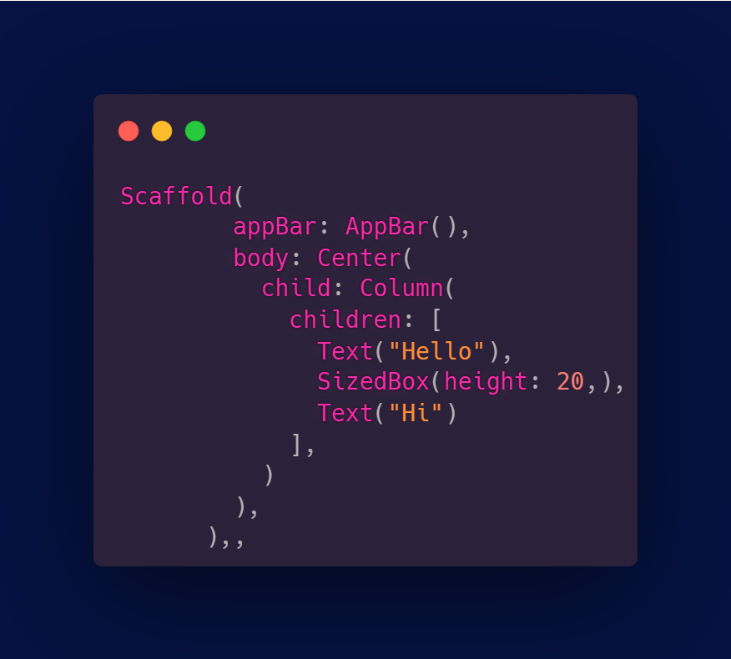
Sized Box
It’s a widget that takes either a height, a width or both, its purpose is to give some space between widgets.

Slide 16
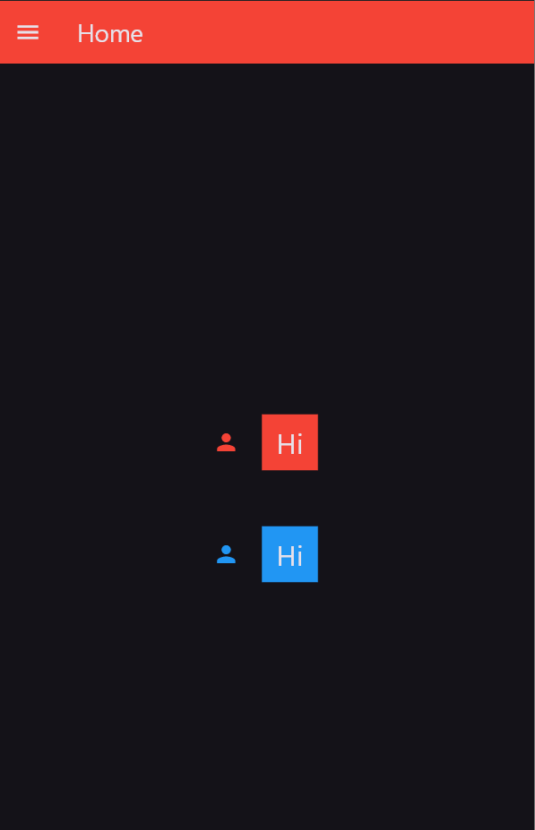
Hands on

Slide 17
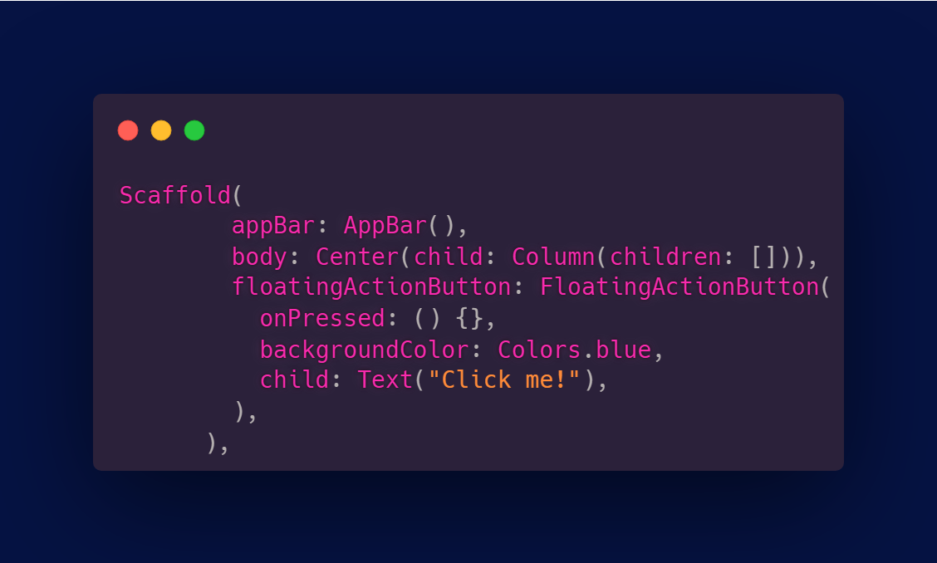
FloatingActionButton
It’s a circular icon button that hovers over the screen.

Slide 18
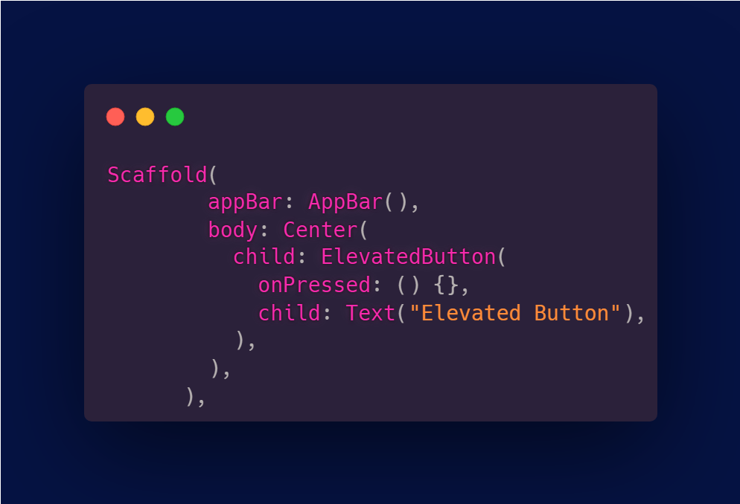
ElevatedButton
One of the buttons widget in flutter, it has a slight elevation look towards the screen.

Slide 19
ElevatedButton
One of the buttons widget in flutter, it has a slight elevation look towards the screen.

Slide 20
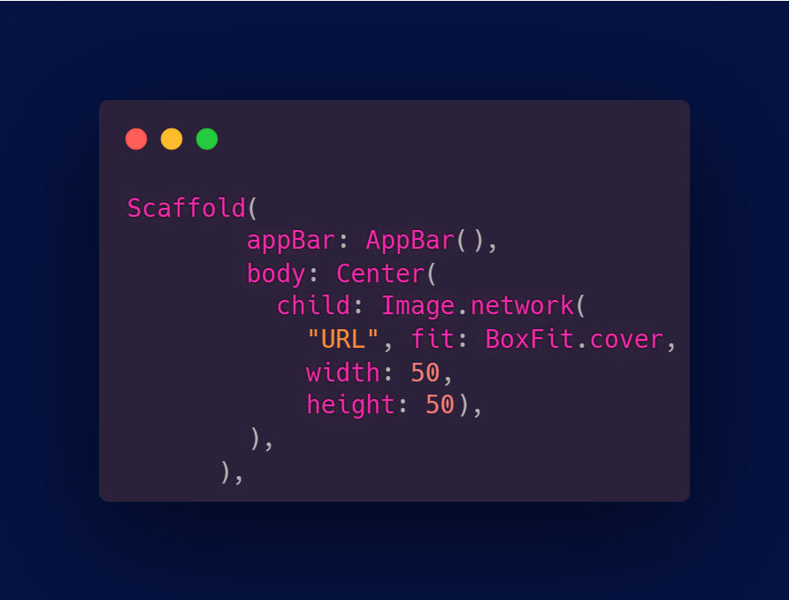
Image.network
A widget that displays images from the internet, you give it the image URL.

Slide 21
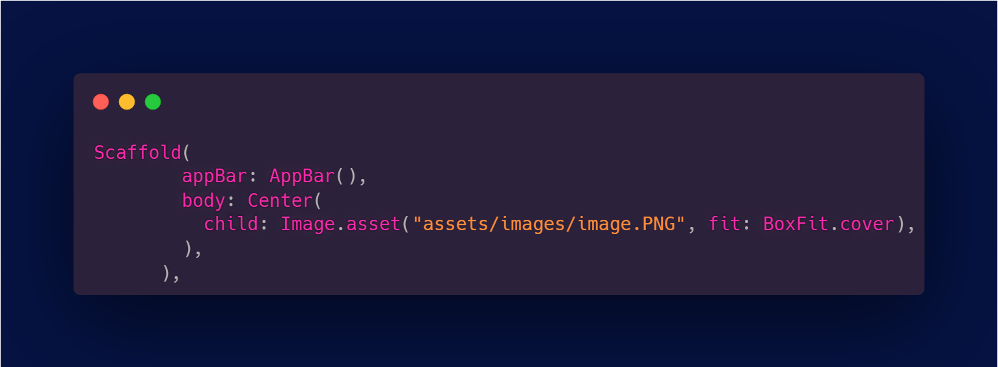
Image.asset
A widget that displays an image from your assets (on your computer).

Slide 22
Thank you!

